Slide 1


Clustering Assignment
BY :- VARAD ANAND

Slide 2
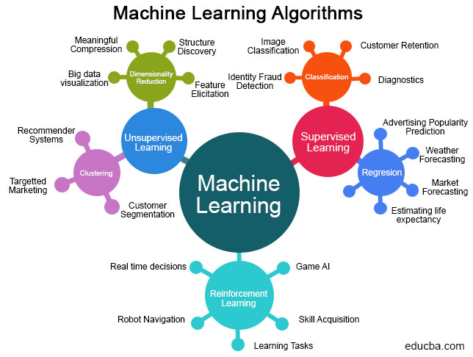
Clustering
Cluster analysis, or clustering, is an unsupervised machine learning task.
It involves automatically discovering natural grouping in data. Unlike supervised learning (like predictive modelling), clustering algorithms only interpret the input data and find natural groups or clusters in feature space.

Slide 3

Problem Statement

Slide 4
HELP International is an international humanitarian NGO that is committed to fighting poverty and providing the people of backward countries with basic amenities and relief during the time of disasters and natural calamities. It runs a lot of operational projects from time to time along with advocacy drives to raise awareness as well as for funding purposes.
After the recent funding programmes, they have been able to raise around $ 10 million. Now the CEO of the NGO needs to decide how to use this money strategically and effectively. The significant issues that come while making this decision are mostly related to choosing the countries that are in the direst need of aid.

Slide 5
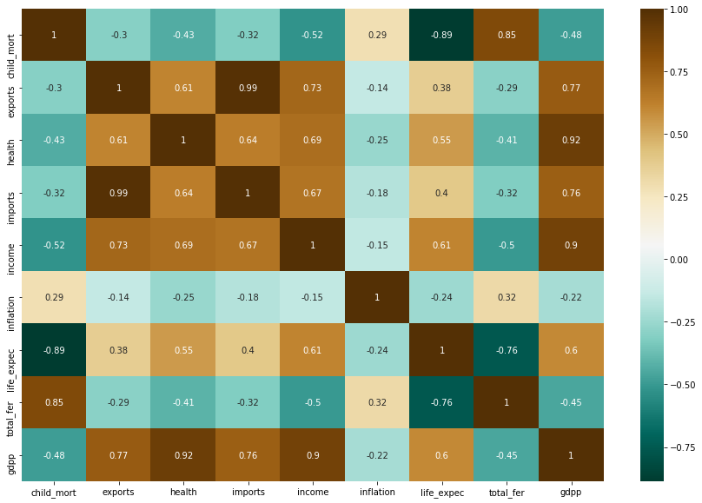
child_mortality and life_expentency are highly correlated with correlation of -0.89
▪ child_mortality and total_ fertility are highly correlated with correlation of 0.85
▪ imports and exports are highly correlated with correlation of 0.74
▪ life_expentency and total_fertility are highly correlated with correlation of -0.76

Slide 6
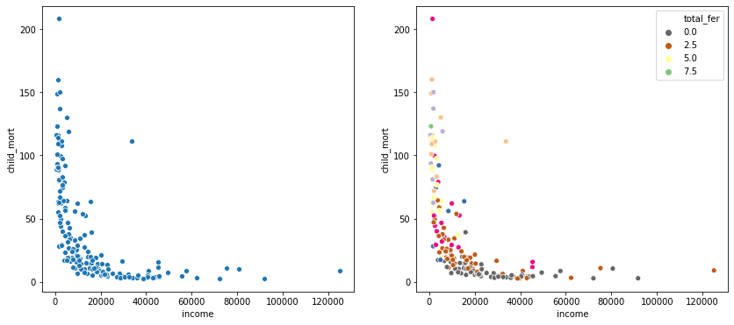
A Scatter Plot is plot which uses cartesian coordinates to display values for typically two variables for a set of data.

Slide 7
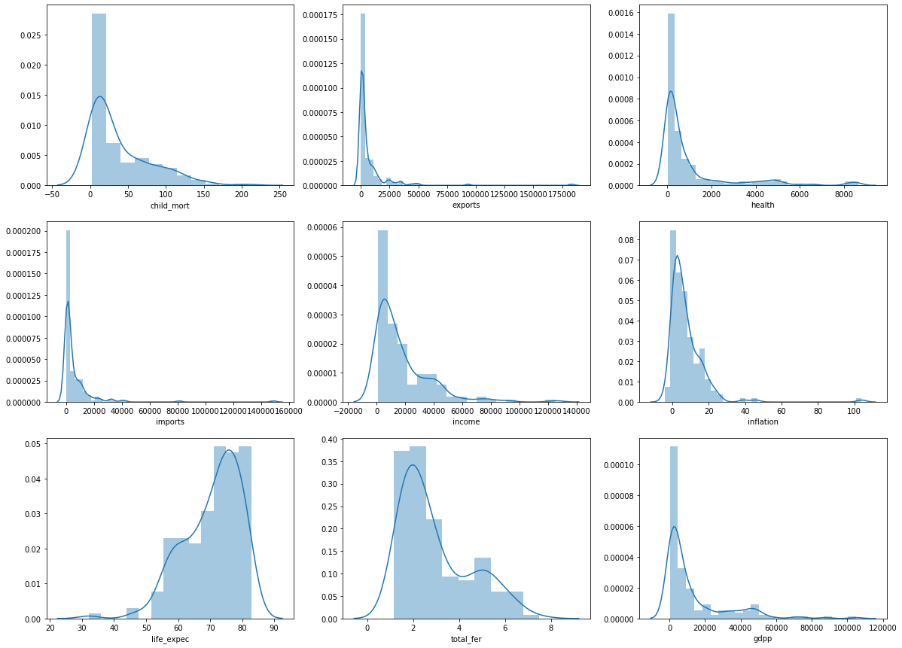
Visualizing The Data Points

Slide 8
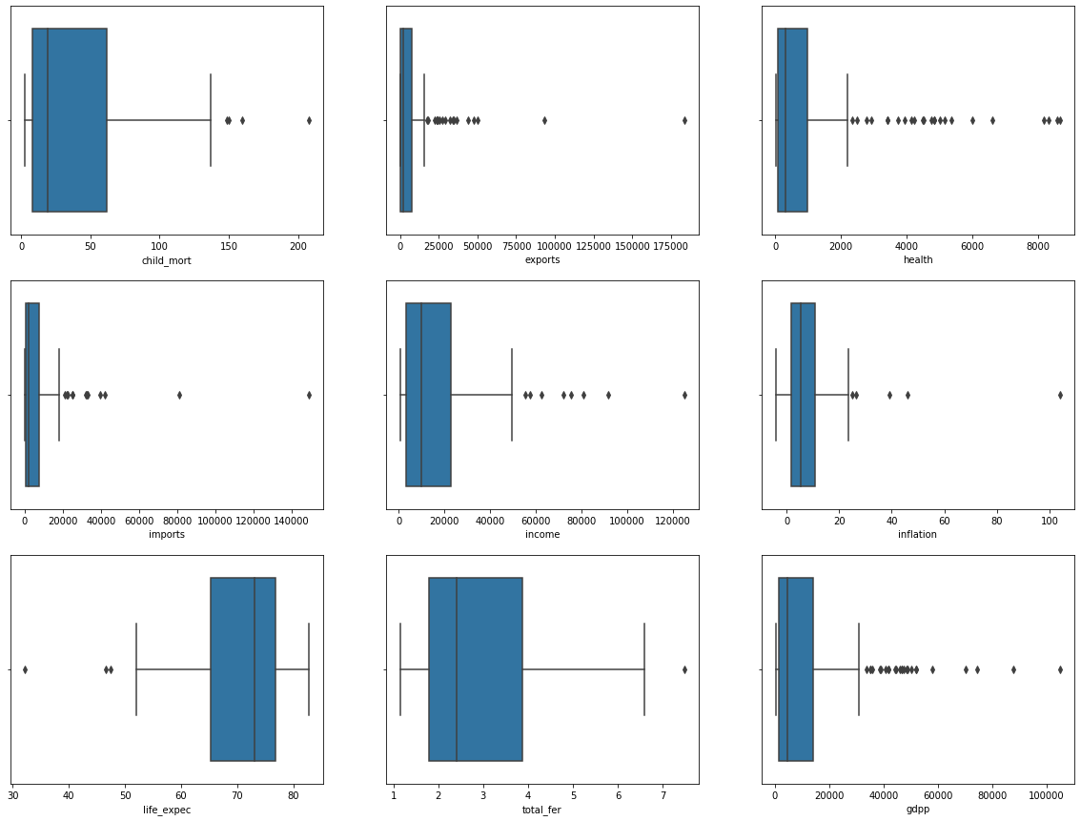
Outliers Analysis
Outliers in input data can skew and mislead the training process of machine learning algorithms resulting in longer training times, less accurate models and ultimately poorer results.
There are two many outliers in health and gdpp.
Since we have limited number of countries(167), removing these outliers would shrink the shape of data and the under-developed countries which are in actual dire need may not contribute to the dataset.

Slide 9
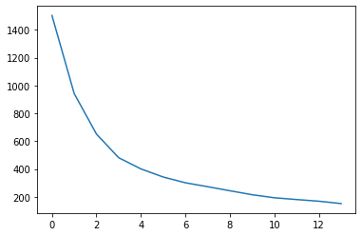
Elbow Curve Method
This method to find the ideal number of clusters.
We can't decide on a clear elbow from the above plot since the plot looks like a smooth curve. But with a common intuition we can say that the number of clusters can be 3 or4

Slide 10
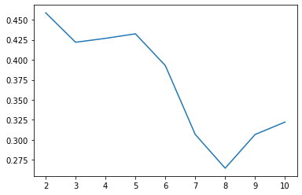
Silhouette score
Silhouette refers to a method of interpretation and validation of consistency within clusters of data.
With the help of Silhouette score plot we can see that, we are getting good scores for cluster numbers = 2,3,4 and . We can see a dip in the score going from 2 to 3 and an increase further going on to 5 clusters.

Slide 11
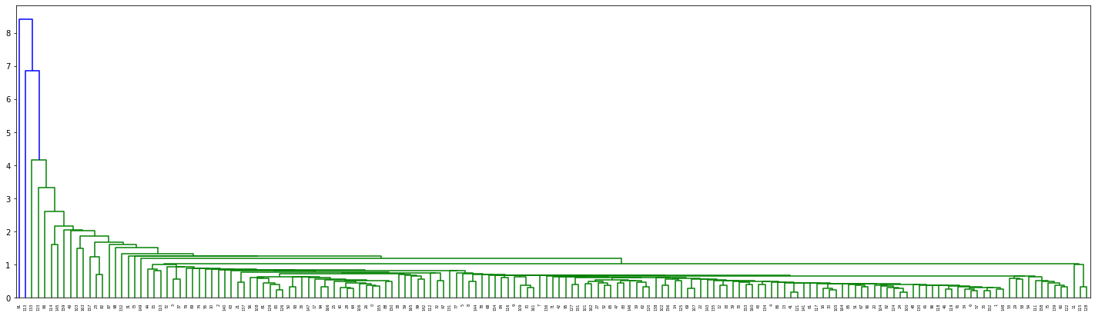
Single Linkage
It is based on grouping clusters in bottom-up fashion (agglomerative clustering), at each step combining two clusters that contain the closest pair of elements not yet belonging to the same cluster as each other.

Slide 12
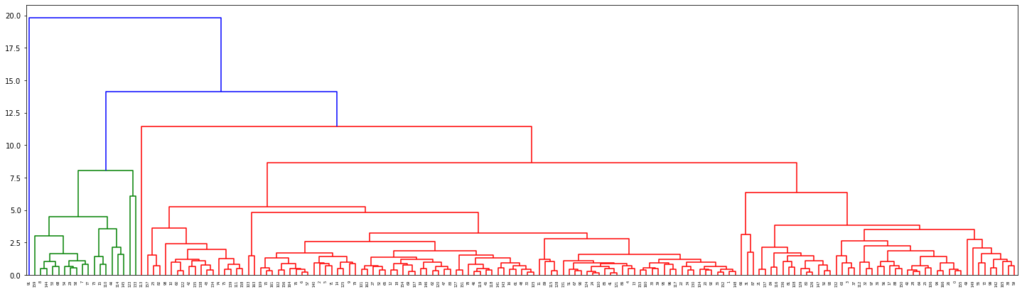
Complete Linkage
At the beginning of the process, each element is in a cluster of its own. The clusters are then sequentially combined into larger clusters until all elements end up being in the same cluster. The method is also known as farthest neighbour clustering. The result of the clustering can be visualized as a dendrogram which shows the sequence of cluster fusion and the distance at which each fusion took place.

Slide 13
Thank You

